Slide 1
UNIT-2
Pandas for Data Handling

Slide 2
What is Pandas?
Open‑source Python library for data manipulation and analysis
Built on top of NumPy
Provides fast, flexible, and expressive data structures
Widely used in Data Science, Machine Learning, and Analytics

Slide 3
Why Pandas?
Handles structured data efficiently
Simplifies data cleaning and preparation
Integrates well with visualization and ML libraries

Slide 4
Pandas vs NumPy:
- NumPy focuses on numerical computation using arrays
- Pandas focuses on data handling and analysis
- Pandas supports heterogeneous data and missing values
- Pandas provides rich file I/O (CSV, Excel, SQL)

Slide 5
Pandas Series:
- One-dimensional labeled data structure
- Each element has an index
- Can store numeric or non-numeric data
- Useful for single-column data

Slide 6
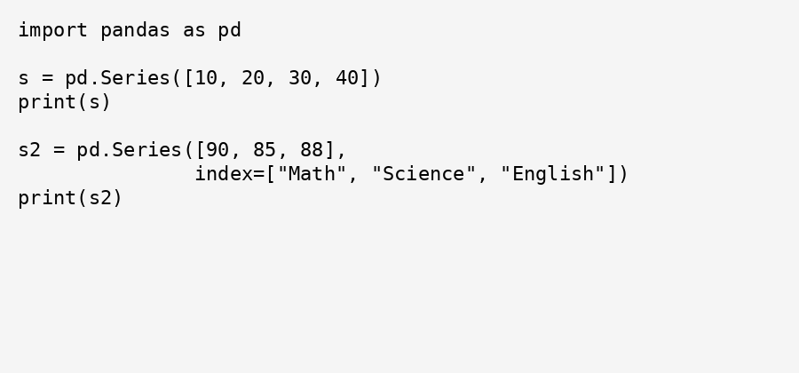
Creating a Pandas Series:

Slide 7
Pandas DataFrame:
- Two-dimensional tabular data structure
- Rows represent observations
- Columns represent features
- Can store multiple data types

Slide 8
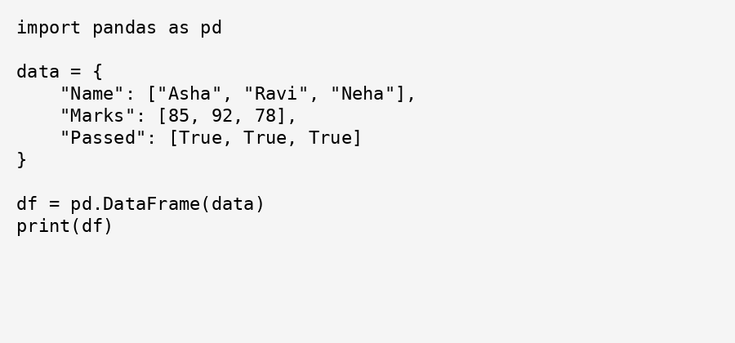
Creating a Pandas DataFrame:

Slide 9
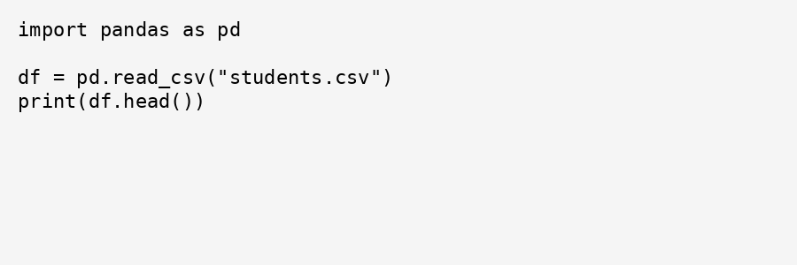
Reading CSV Files:
- CSV is a common data storage format
- Pandas provides read_csv() function
- Automatically creates a DataFrame

Slide 10
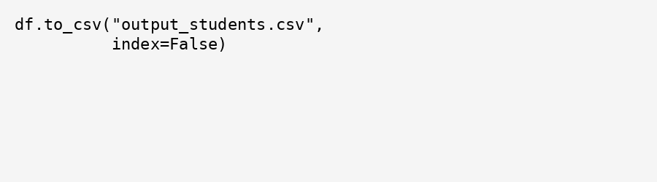
Writing CSV Files:
- Processed data can be saved to CSV
- Useful for reporting and reuse
- Controlled using to_csv()
Why index=False?
Prevents writing row index as an extra column

Slide 11
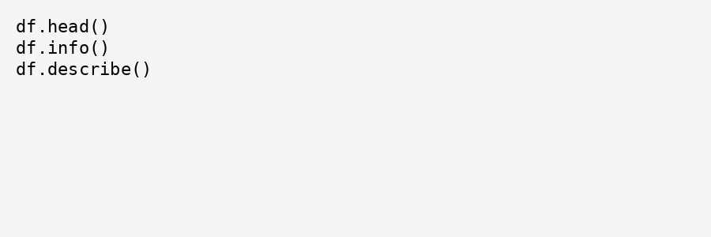
Inspecting Datasets:
- Understand structure and quality of data
- Identify missing values and data types
- Decide preprocessing steps

Slide 12
Inspecting Dataset – Basic Methods:
Common inspection functions:
head() – First few rows
tail() – Last few rows
info() – Structure and data types
describe() – Statistical summary

Slide 13
Understanding Dataset Shape and Columns:
shape – Number of rows and columns
columns – Column names
index – Row labels
Why it matters:
Confirms dataset size
Helps in feature selection
Avoids dimension mismatch errors

Slide 14
Selecting Data:
- Select specific columns or rows
- Useful for feature selection
- Reduces data complexity

Slide 15
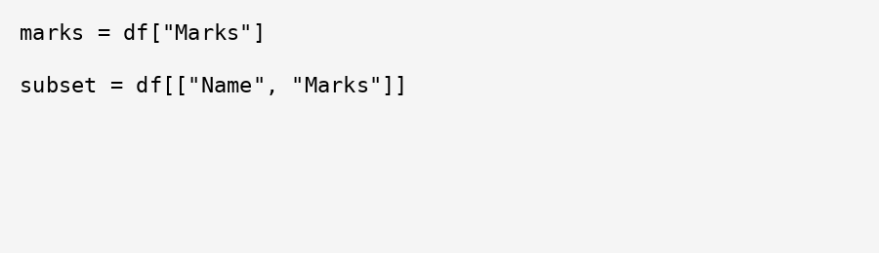
Selecting Columns:
Single column selection → returns Series
Multiple column selection → returns DataFrame
Typical Use Cases:
Feature extraction
Target variable selection

Slide 16
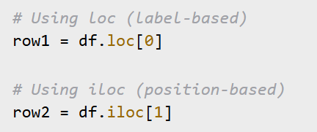
Selecting Rows using loc & iloc:

Slide 17
loc vs iloc:
loc:
Label‑based indexing
Includes both start and end labels
iloc:
Integer‑based indexing
End index is excluded

Slide 18
Filtering Data:
- Select rows based on conditions
- Helps focus on relevant data
- Improves analysis accuracy

Slide 19
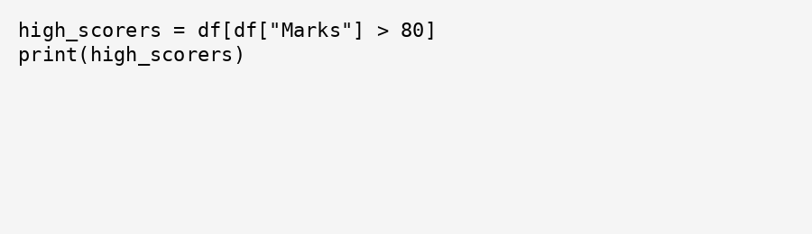
Filtering Data Using Conditions:
Condition creates a boolean mask
Only rows satisfying the condition are selected

Slide 20
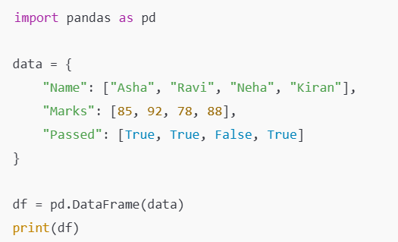

Filtering with Multiple Conditions:
Combine conditions using:
AND (&)
OR (|)

Slide 21
Best Practices
- Always inspect data before analysis
- Handle missing values carefully
- Use meaningful column names
- Validate filtered results

Slide 22
Create Dataframe for this:
ID | Color | Size | City | Crop | Yield
1 | Red | Small | Delhi | Rice | 20
2 | Blue | Medium | Mumbai | Wheat | 25
3 | Green | Large | Delhi | Rice | 22
4 | Blue | Small | Chandigarh | Maize | 18
5 | Red | Medium | Mumbai | Wheat | 30

